Slide 1
Econ 7900
Statistics for Data Science
Instructor: CAO Kang Hua 曹康華
Lecture 3
Statistical Inference: Confidence Intervals

Slide 2
Statistical Inference Methods
Statistical Inference methods are important for two primary reasons:
Statistical inference methods use probability calculations that assume that the data were gathered with a random sample or a randomized experiment.
The probability calculations refer to a sampling distribution of a statistic, which is often approximately a normal distribution.

Slide 3
Statistical Inference Methods
There are two types of statistical inference methods—estimation of population parameters and testing hypotheses about the parameter values.
The most informative estimation method constructs an interval of numbers, called a confidence interval, within which the unknown parameter value is believed to fall.

Slide 4
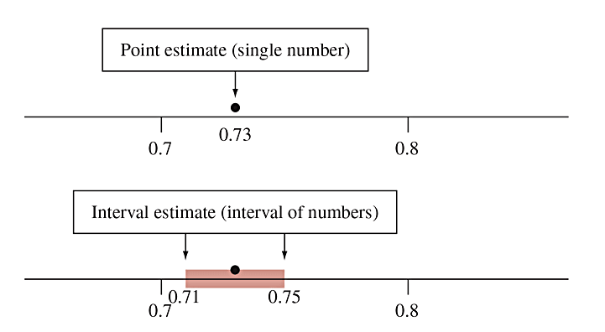
Point Estimate and Interval Estimate
A point estimate is a single number that is our “best guess” for the parameter.
An interval estimate is an interval of numbers that is believed to contain the actual value of the parameter.
Figure 8.1 A Point Estimate Predicts a Parameter by a Single Number. An interval estimate is an interval of numbers that are believable values for the parameter. Question Why is a point estimate alone not sufficiently informative?

Slide 5
Point Estimate and Interval Estimate
A point estimate by itself is not sufficient because it doesn’t tell us how close the estimate is likely to be to the parameter.
An interval estimate is more useful, it incorporates a margin of error which helps us to gauge the accuracy of the point estimate.

Slide 6
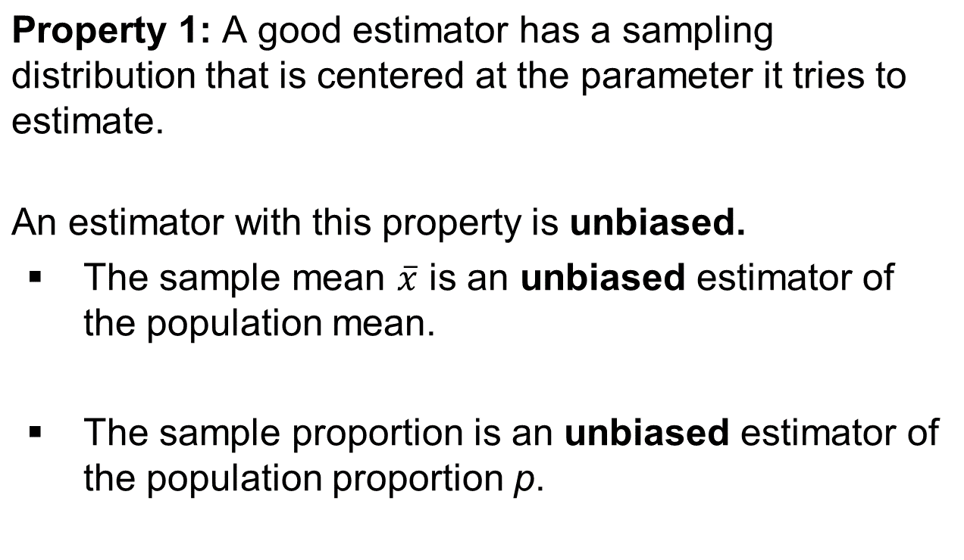
Properties of Point Estimators

Slide 7
Properties of Point Estimators
Property 2: A good estimator has a small standard deviation compared to other estimators.
  This tells us the estimator tends to fall closer than other estimates to the parameter.
  The sample mean has a smaller standard deviation than the sample median when estimating the center of a normal distribution.

Slide 8
Confidence Interval
A confidence interval is an interval containing the most believable values for a parameter.
The probability that this method produces an interval that contains the parameter is called the confidence level.
  This is a number chosen to be close to 1, most commonly 0.95.

Slide 9
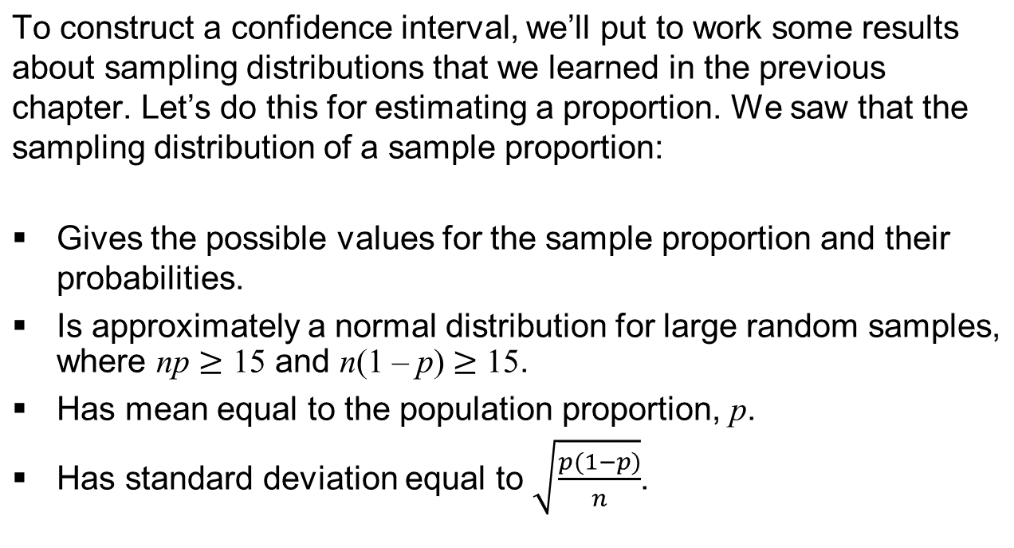
The Logic behind Constructing a Confidence Interval

Slide 10
The Logic behind Constructing a Confidence Interval
Fact: Approximately 95% of a normal distribution falls within 2 standard deviations of the mean.
  Since the sampling distribution of the sample proportion is normal, with probability 0.95, the sample proportion falls within about 1.96 standard deviations of the population proportion.
  The distance of 1.96 standard deviations is the margin of error.

Slide 11
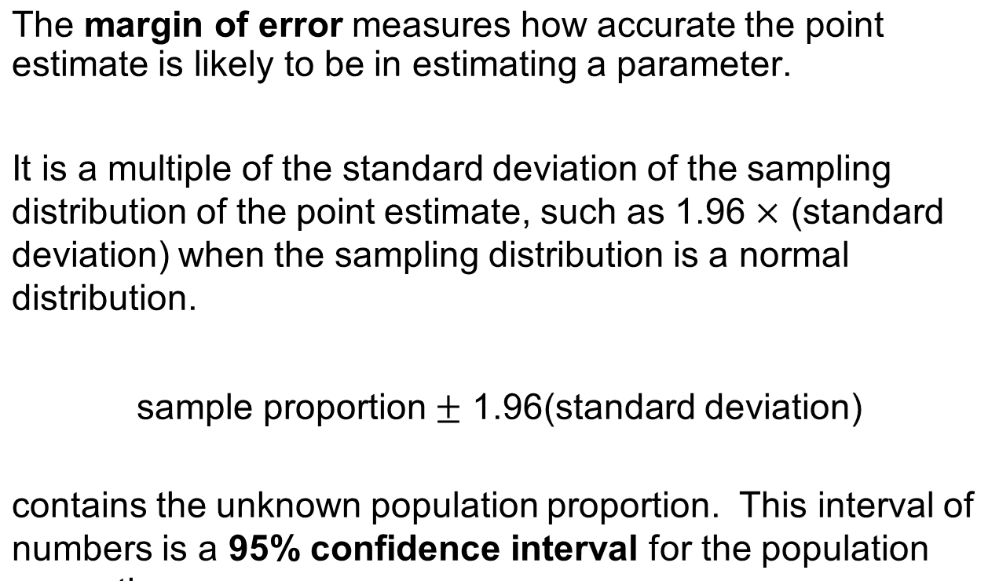
Margin of Error

Slide 12
Example: Confidence Interval for a Proportion: A Wife's Career
The GSS asked whether individuals agreed or disagreed with the following statement: “It is much better for everyone involved if the man is the achiever outside the home and the woman takes care of the home and family.” In 2012, 31% of 1285 respondents agreed.
Assuming an estimated standard deviation of 0.01, find the margin of error for a 95% confidence interval for the population proportion who agreed with the statement. Construct the 95% confidence interval and interpret.
  Margin of error =
  We predict that the population proportion who would agree is somewhere between 0.29 and 0.33.

Slide 13
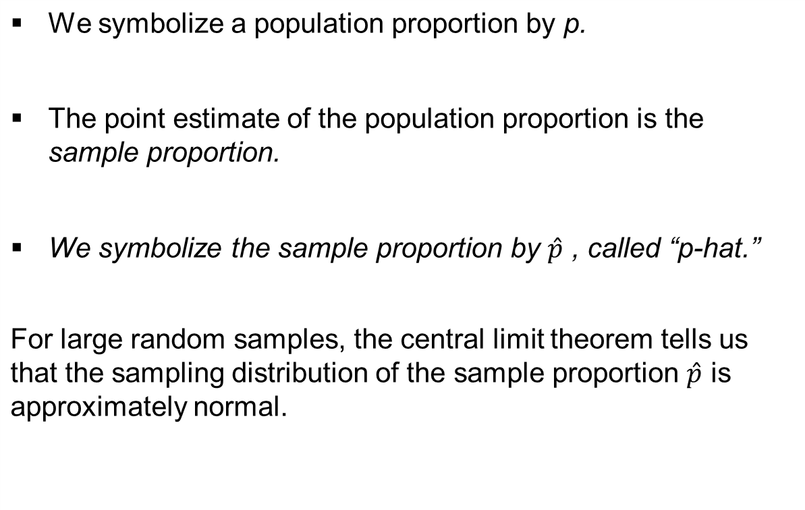
Finding the 95% Confidence Interval for a Population Proportion

Slide 14
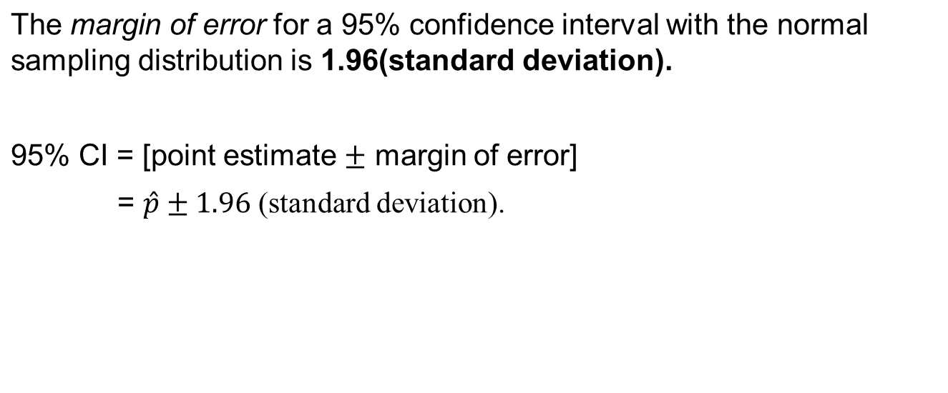
Finding the 95% Confidence Interval for a Population Proportion

Slide 15
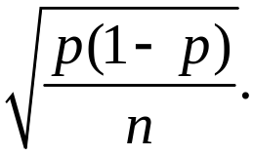
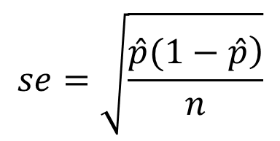
Finding the 95% Confidence Interval for a Population Proportion
The standard deviation of a sample proportion equals:
This formula depends on the unknown population proportion, p.
In practice, we don’t know p, and we need to estimate the standard deviation as the standard error (se).

Slide 16
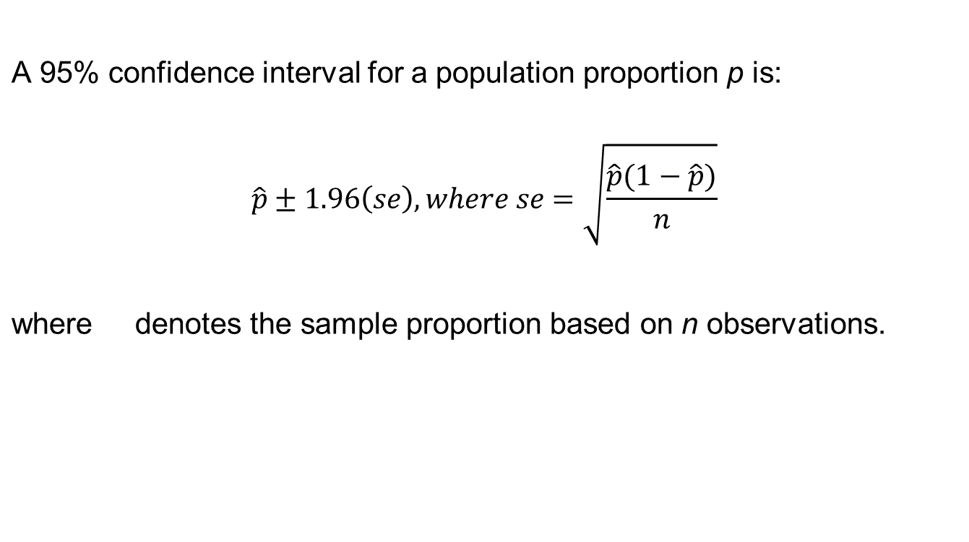

Finding the 95% Confidence Interval for a Population Proportion

Slide 17
Example: Paying Higher Prices to Protect the Environment
In 2010, the GSS asked subjects if they would be willing to pay much higher prices to protect the environment.
  Of n = 1,361 respondents, 637 were willing to do so.
Find and interpret a 95% confidence interval for the population proportion of adult Americans willing to do so at the time of the survey.

Slide 18
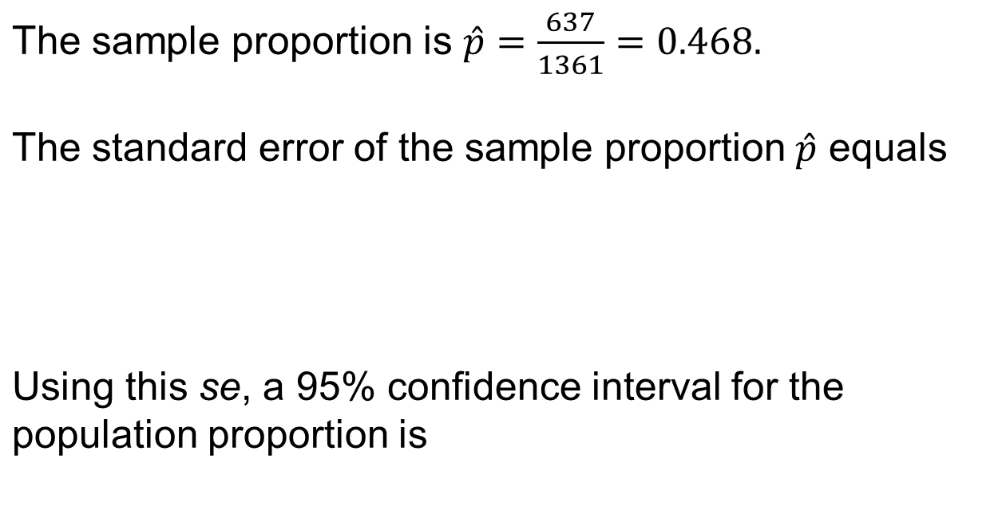
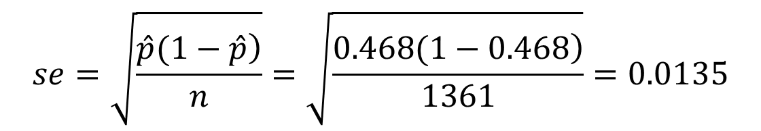
Example: Paying Higher Prices to Protect the Environment

Slide 19
Example: Paying Higher Prices to Protect the Environment
At the 95% confidence level, we estimate that the population proportion of adult Americans willing to pay much higher prices to protect the environment was at least 0.44 but no more than 0.49, that is, between 44% and 49%.
The point estimate of 0.47 has a margin of error of 0.026.

Slide 20
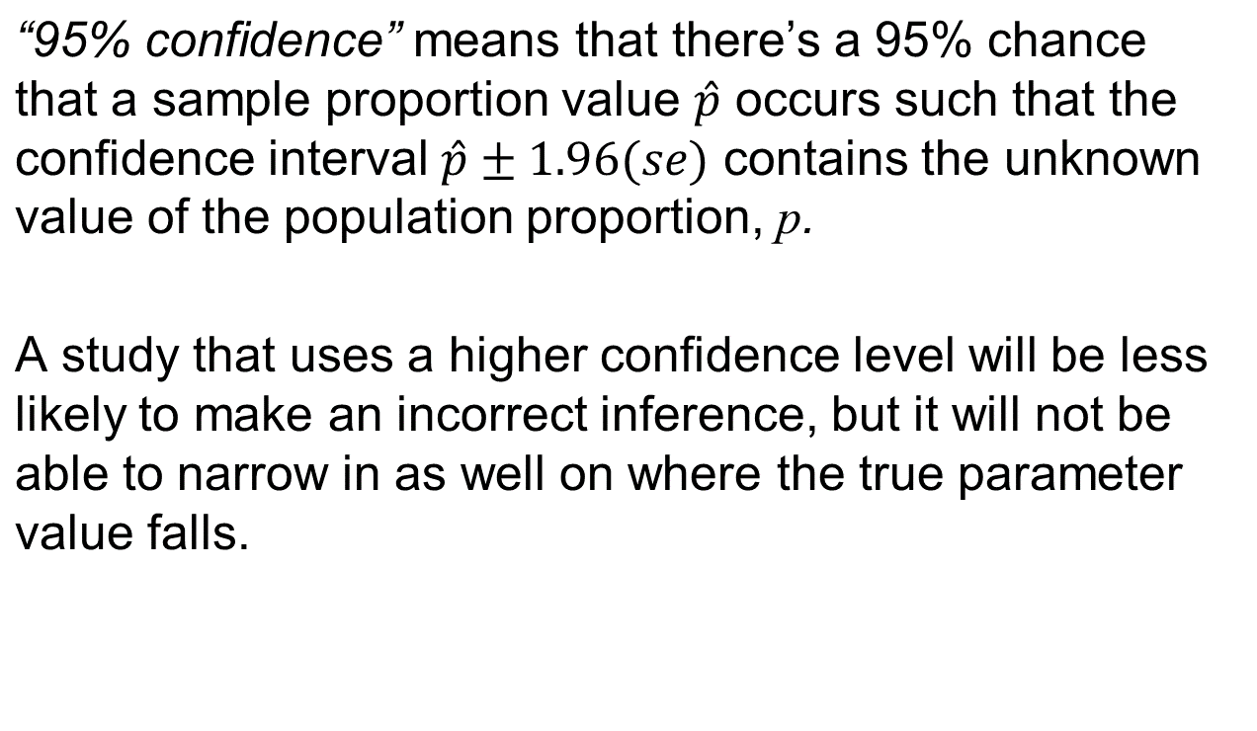
Using a Confidence Level Other than 95%

Slide 21
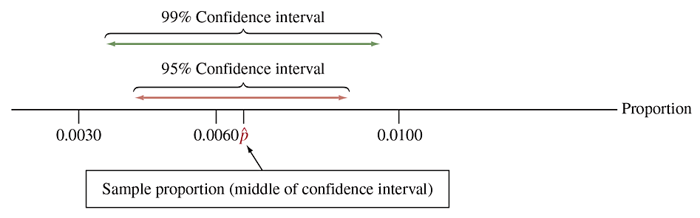
How Can We Use Confidence Levels Other than 95%?
In practice, the confidence level 0.95 is the most common choice. But, some applications require greater (or less) confidence.
To increase the chance of a correct inference, we can use a larger confidence level, such as 0.99.
Figure 8.4 A 99% Confidence Interval Is Wider Than a 95% Confidence Interval.
Question: If you want greater confidence, why would you expect a wider interval?

Slide 22
How Can We Use Confidence Levels Other than 95%?
In using confidence intervals, we must compromise between the desired margin of error and the desired confidence of a correct inference.
As one gets better, the other gets worse. This is why you would probably not use a 99.9999% confidence interval. It would usually have too large a margin of error to tell you much about where the parameter falls (its z-score is 4.9).
In practice, 95% confidence intervals are the most common.

Slide 23
Example: Influenza Vaccine
To test the effectiveness of a new method of vaccine, which allows growing viruses in cell cultures, in a recent clinical trial n = 3900 randomly selected healthy subjects aged 18–49 received a cell-derived influenza vaccine by injection. During a follow- up period of approximately 28 weeks, each subject was assessed whether he or she developed influenza, which happened for 26 of the 3900 subjects.
Find a 99% confidence interval for the population proportion developing the flu over the follow-up period.

Slide 24
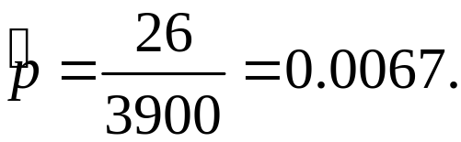
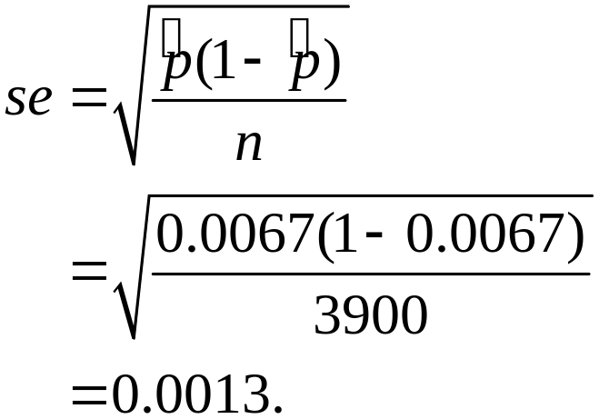
Example: Influenza Vaccine
Find a 99% confidence interval for the population proportion developing the flu over the follow-up period.
The 99% confidence interval is

Slide 25
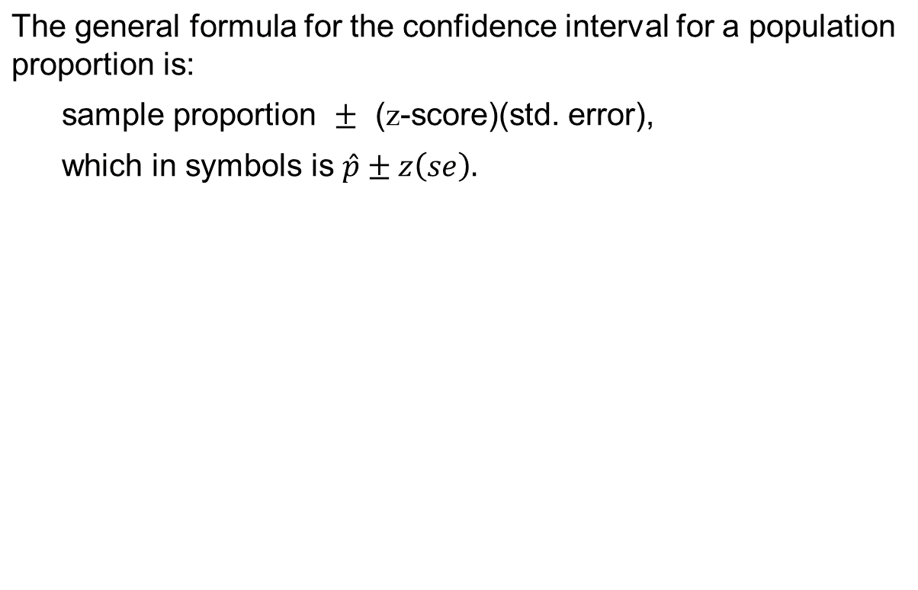
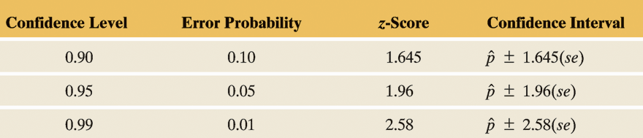
Error Probability for the Confidence Interval Method

Slide 26
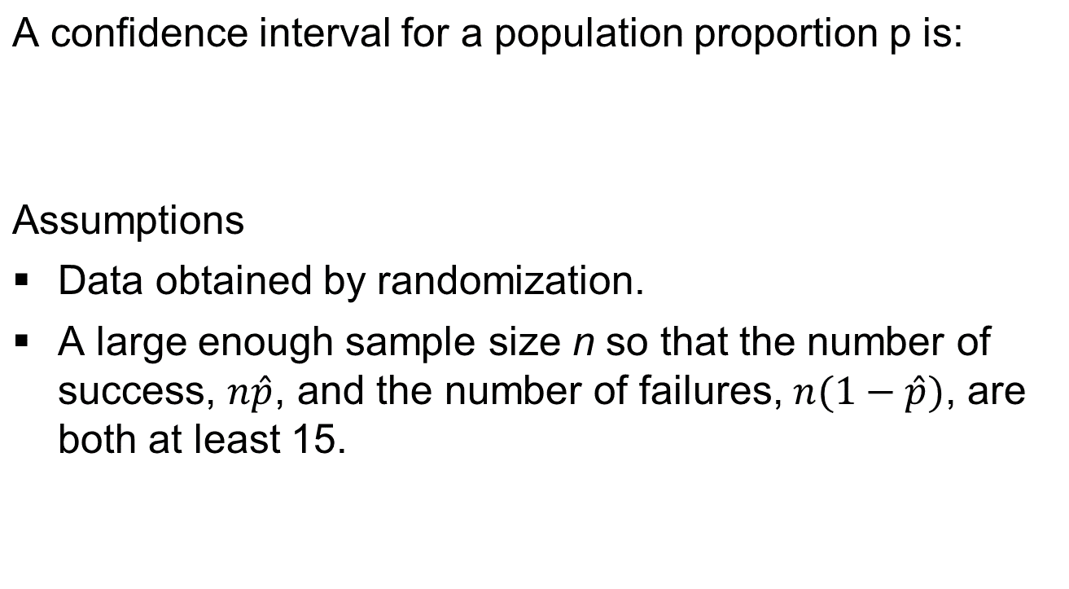
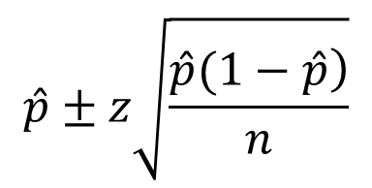
Summary: Confidence Interval for a Population Proportion, p

Slide 27
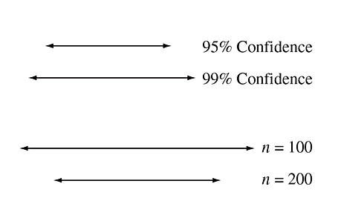
Effects of Confidence Level and Sample Size on Margin of Error
The margin of error for a confidence interval:
Increases as the confidence level increases
Decreases as the sample size increases.
  For instance, a 99% confidence interval
  is wider than a 95% confidence interval,
  and a confidence interval with 200
  observations is narrower than one with
  100 observations at the same confidence
  level. These properties apply to all confidence
  intervals, not just the one for the population proportion.

Slide 28
Interpretation of the Confidence Level
So, what does it mean to say that we have “95% confidence”?
The meaning refers to a long-run interpretation—how the method performs when used over and over with many different random samples.
If we used the 95% confidence interval method over time to estimate many population proportions, then in the long run about 95% of those intervals would give correct results, containing the population proportion.

Slide 29
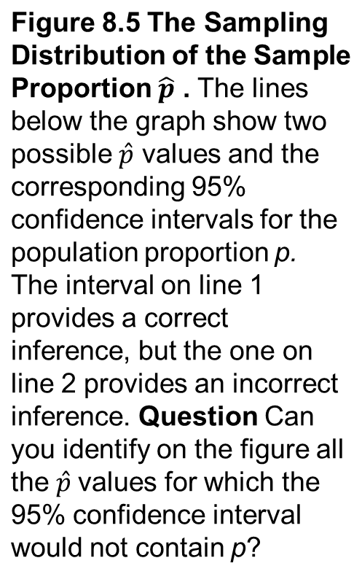
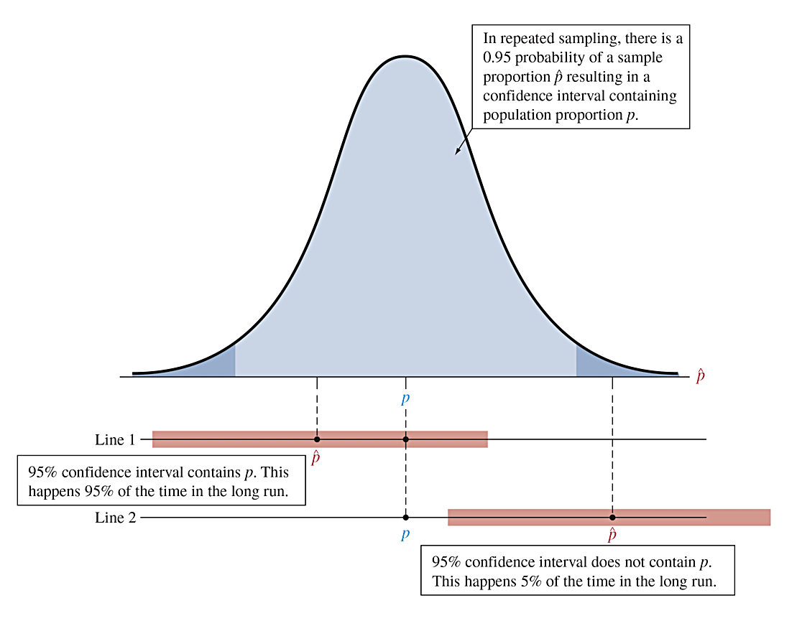
Interpretation of the Confidence Level

Slide 30
Long Run Versus Subjective Probability Interpretation of Confidence
You might be tempted to interpret a statement such as “We can be 95% confident that the population proportion p falls between 0.42 and 0.48” as meaning that the probability is 0.95 that p falls between 0.42 and 0.48. However, probabilities apply to statistics (such as the sample proportion), not to parameters (such as the population proportion).
The 95% confidence refers not to a probability for the population proportion p but rather to a probability that applies to the confidence interval method in its relative frequency sense: If we use it over and over for various samples, in the long run we make correct inferences (i.e., cover the true parameter) 95% of the time.

Slide 31
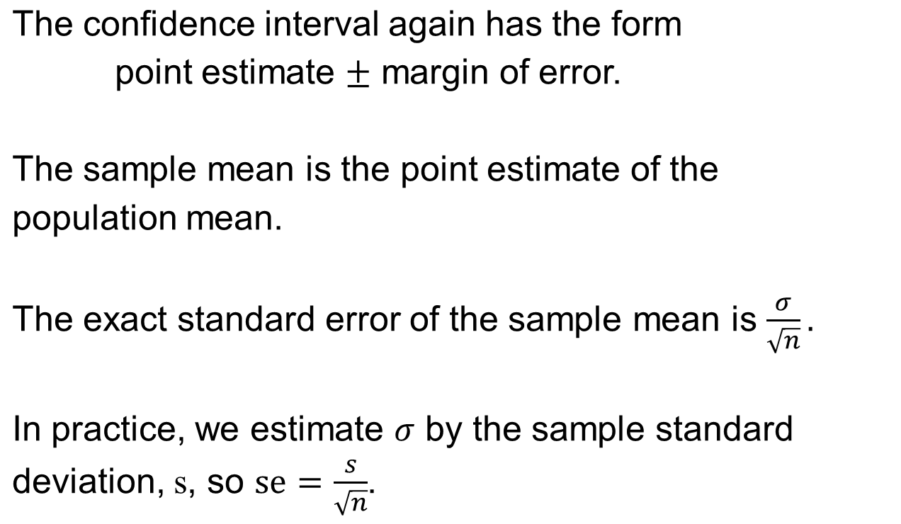
How to Construct a Confidence Interval for a Population Mean

Slide 32
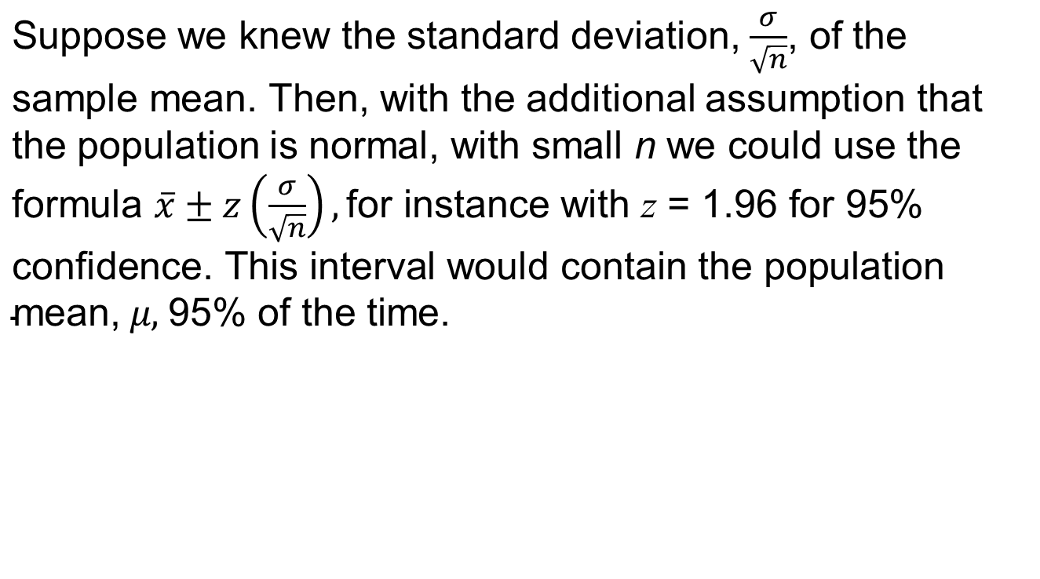
The t Distribution and Its Properties

Slide 33
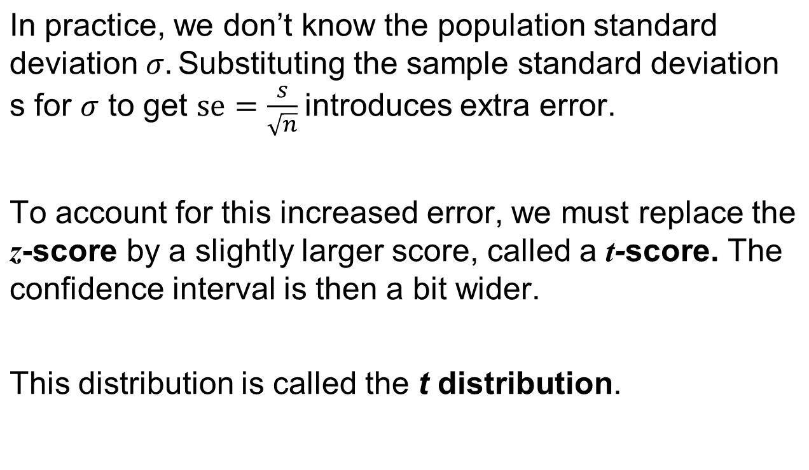
The t Distribution and Its Properties

Slide 34
The t Distribution and Its Properties
The t distribution resembles the standard normal distribution, being bell-shaped around a mean of 0.
Its standard deviation is a bit larger than 1, the precise value depending on what is called the degrees of freedom, denoted by df.
For inference about a population mean, the degrees of freedom equal df = n – 1, one less than the sample size.

Slide 35
Summary: Properties of the t Distribution
The t distribution is bell-shaped and symmetric about 0.
The probabilities depend on the degrees of freedom,
df = n – 1.
The t distribution has thicker tails than the standard normal distribution, i.e., it is more spread out.
A t -score multiplied by the standard error gives the margin of error for a confidence interval for the mean.

Slide 36
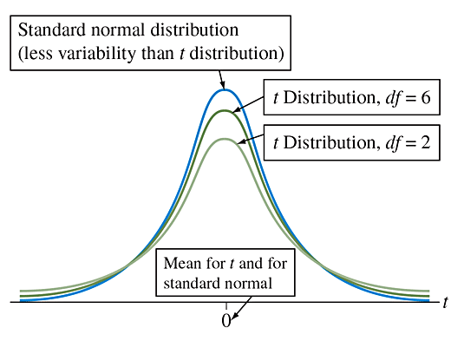
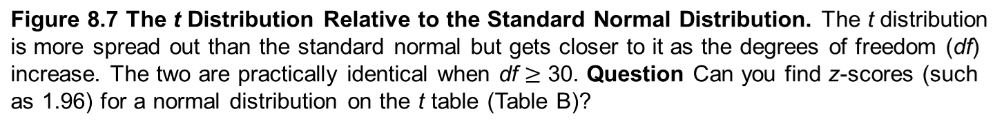
t Distribution

Slide 37
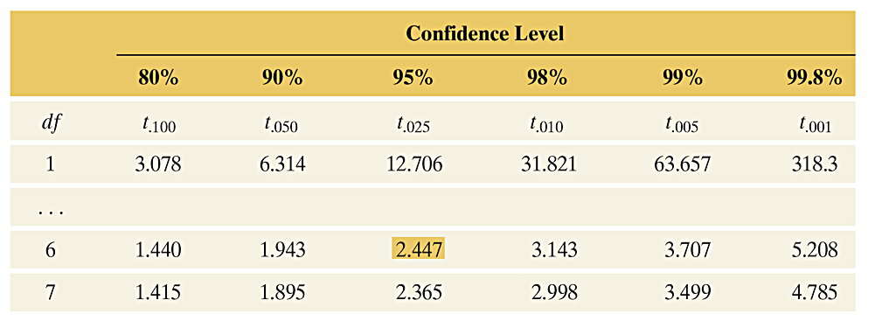
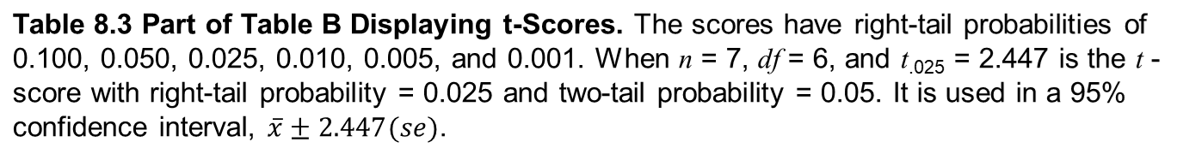
t Distribution

Slide 38
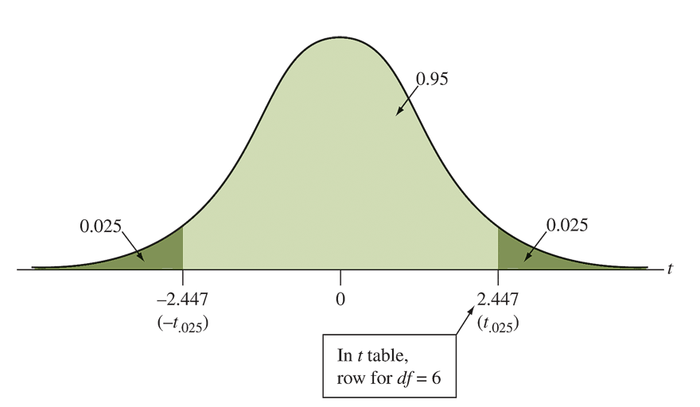
t Distribution
Figure 8.8 The t Distribution with df = 6. 95% of the distribution falls between -2.447 and 2.447. These t -scores are used with a 95% confidence interval when n = 7.
Question Which t -scores with df = 6 contain the middle 99% of a t distribution (for a 99% confidence interval)?

Slide 39
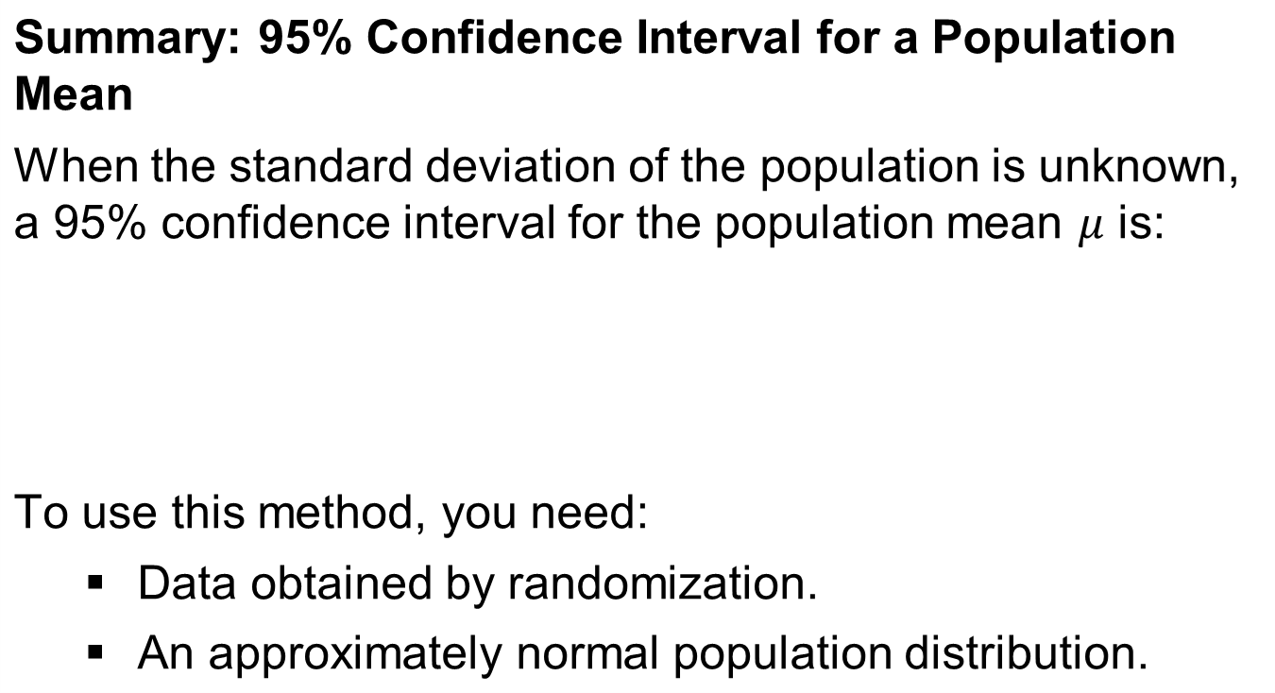
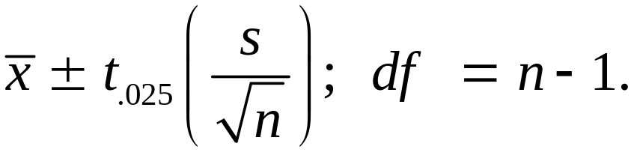
Using the t Distribution to Construct a Confidence Interval for a Mean

Slide 40
Example: Buying on eBay
eBay is a popular Internet company for auctioning just about anything. How much can you save by buying items on eBay compared to their actual retail price?
Following is a random sample of 11 completed auctions for an unlocked Apple iPhone 5s with 16GB storage in new condition (i.e., item not used, but original packaging might be missing), obtained from eBay in July 2014.
Closing Price (in $): 570, 620, 610, 590, 540, 590, 565, 590, 580, 570, 595.
Use numerical summaries and graphical displays to check the assumptions for using these data to find a 95% confidence interval for the mean closing price on eBay. Find the 95% confidence interval and interpret it.

Slide 41
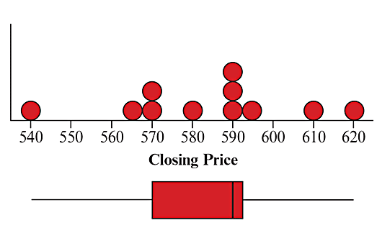
Example: Buying on eBay
Use numerical summaries and graphical displays to check the assumptions for using these data to find a 95% confidence interval for the mean closing price on eBay. Find the 95% confidence interval and interpret it.
Figure 8.9 Dot Plot and Box Plot for closing prices of the 16GB iPhone 5s auctioned on eBay in July 2014. Question What other plot could you use to display the data?

Slide 42
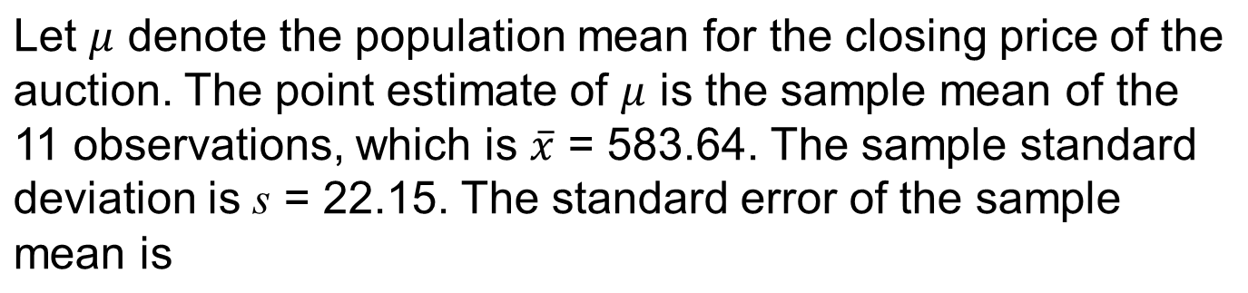
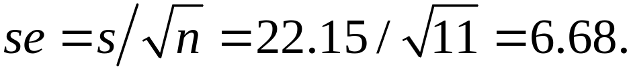
Example: Buying on eBay

Slide 43
Example: Buying on eBay
Because n = 11, the degrees of freedom to use for the t-score are df = 11 - 1 = 10. For a 95% confidence interval, from Table B in the appendix, we use t.025 = 2.228. The 95% confidence interval is
With 95% confidence, the range of believable values for the mean closing price of an unlocked 16 GB iPhones 5s posted for sale on eBay in new condition is $569 to $599.

Slide 44
Finding a t Confidence Interval for Other Confidence Levels
The 95% confidence interval uses t_{.025} since 95% of the probability falls between -t_{.025} and t_{.025}.
For 99% confidence, the error probability is 0.01 with 0.005 in each tail and the appropriate t-score is t_{.005}.
To get other confidence intervals use the appropriate t-value from Table B.

Slide 45
If the Population Is Not Normal, Is the Method Robust?
Knowing that a statistical method is robust (that is, it still performs adequately) even when a particular assumption is violated is important because in practice assumptions are rarely perfectly satisfied.
Confidence intervals for a mean using the t distribution are
robust against most violations of the normal population assumption. However, you should check the data graphically to identify outliers that could affect the validity of the mean or its confidence interval.
Also, unless the data production used randomization, statistical inference may be inappropriate.

Slide 46

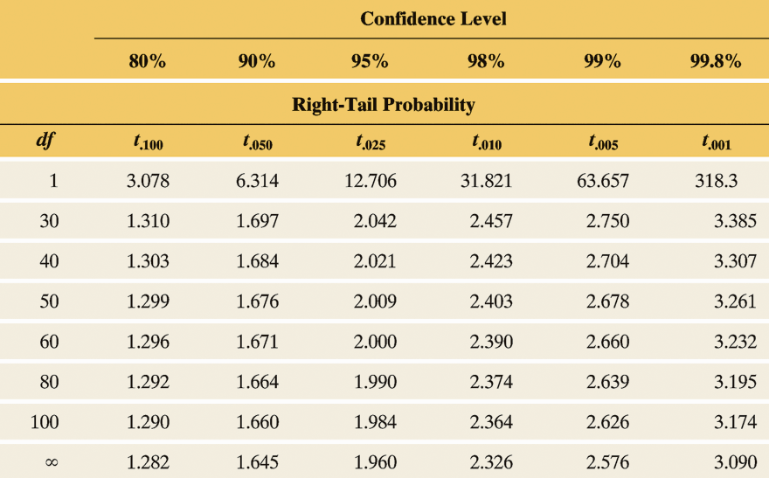

Slide 47
Sample Size for Estimating a Population Proportion
To determine the sample size to estimate a population proportion,
first, we must decide on the desired margin of error.
second, we must choose the confidence level for achieving that margin of error.
In practice, 95% confidence intervals are most common.

Slide 48
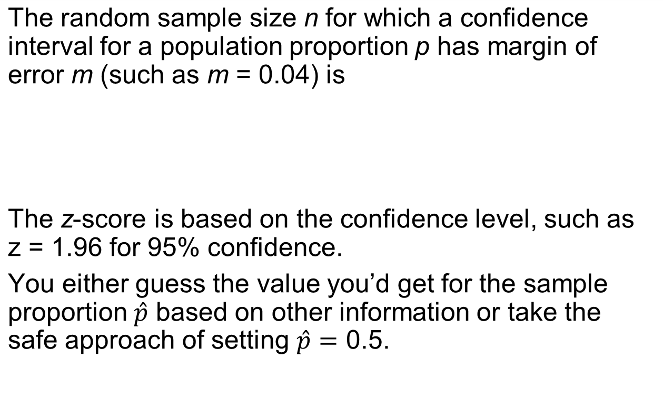
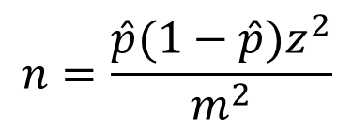
Summary: Sample Size for Estimating a Population Proportion

Slide 49
Example: Sample Size For Exit Poll
An election is expected to be close. Pollsters planning an exit poll decide that a margin of error of 0.04 is too large.
How large should the sample size be for the margin of error of a 95% confidence interval to equal 0.02?

Slide 50
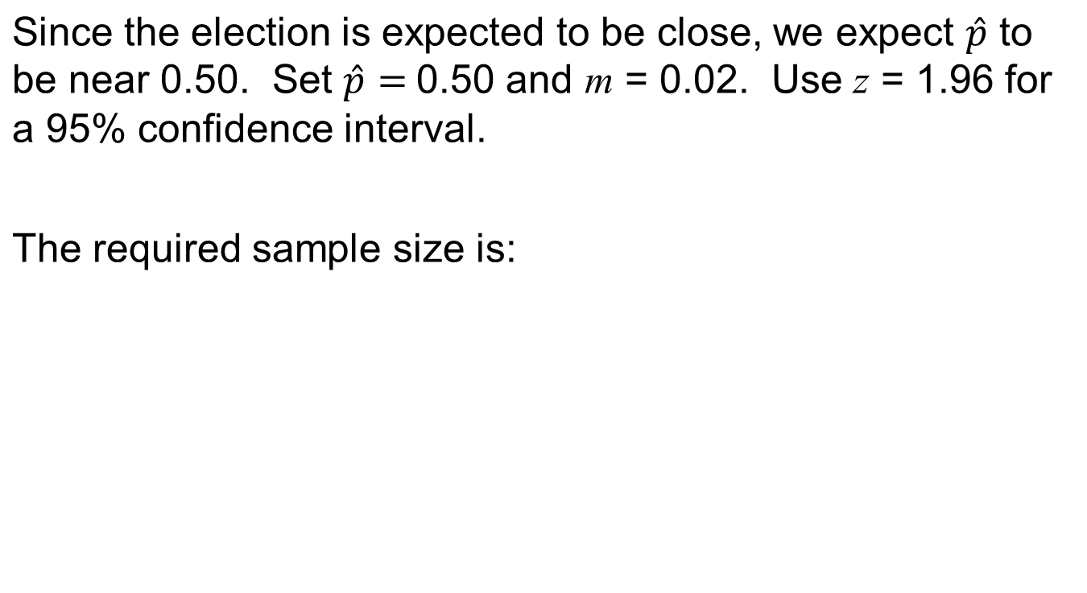
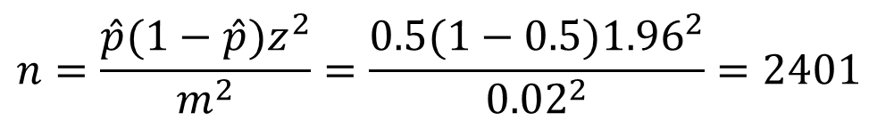
Example: Sample Size For Exit Poll

Slide 51
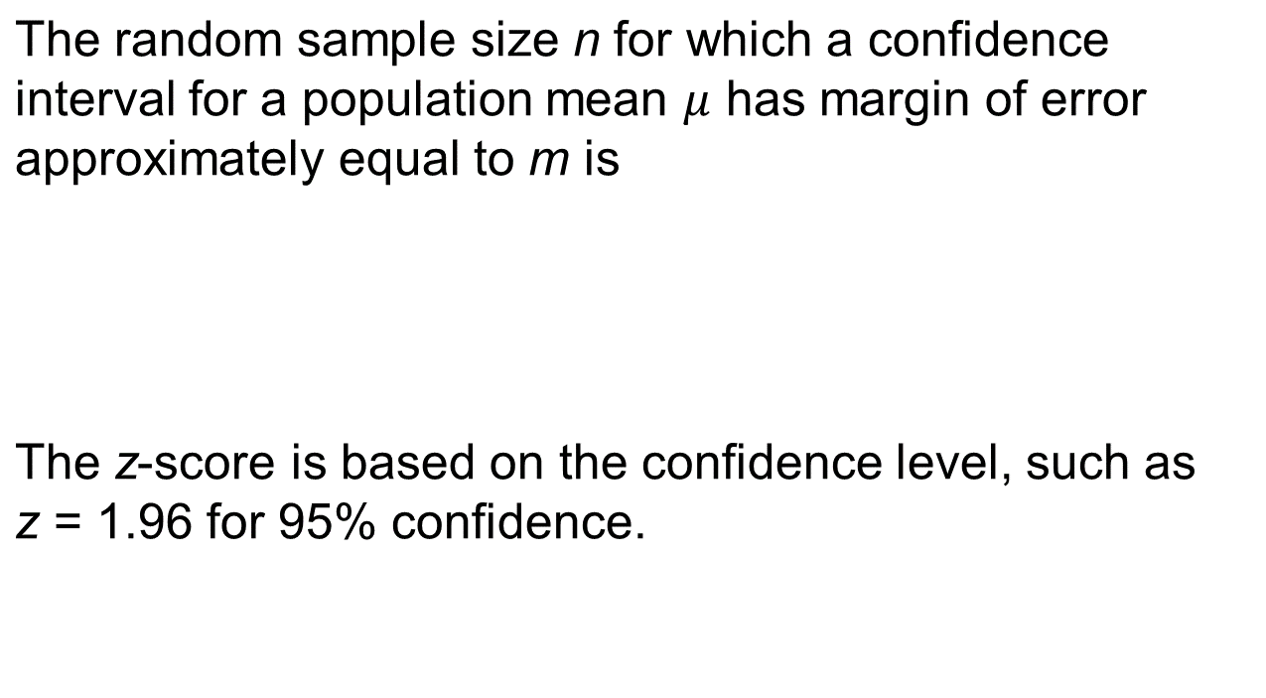
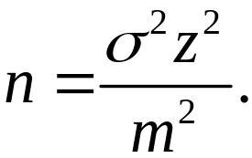
Choosing the Sample Size for Estimating a Population Mean

Slide 52
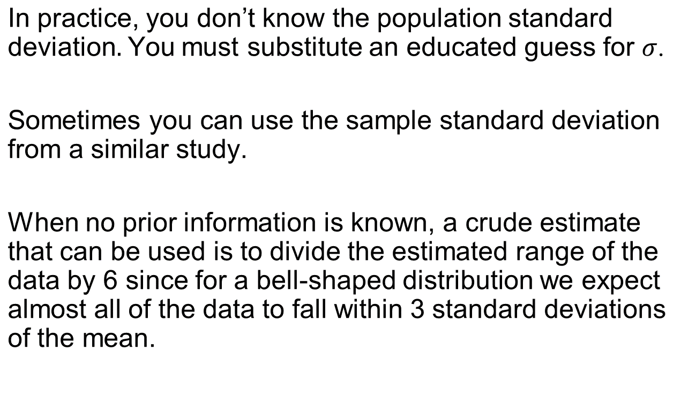
Choosing the Sample Size for Estimating a Population Mean

Slide 53
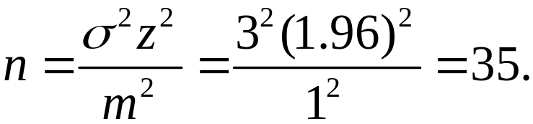
Example: Estimating Mean Education in South Africa
A social scientist studies adult South Africans to investigate educational attainment in the black community.
How large a sample size is needed so that a 95% confidence interval for the mean number of years of education has margin of error equal to 1 year?
Assume that the education values will fall within a range of 0 to 18 years. The desired margin of error is m = 1.

Slide 54
Other Factors That Affect the Choice of the Sample Size
The first is the desired precision, as measured by the margin of error, m.
The second is the confidence level.
The third factor is the variability in the data.
  The fourth factor is cost.

Slide 55
Using a Small n
The t methods for a mean are valid for any n.
  When n is small, you need to be extra cautious to look for extreme outliers or great departures from the normal population assumption.
The numbers of successes and failures must both be at least 15 for the normal distribution to approximate well the binomial distribution or the sampling distribution of a sample proportion.

Slide 56
The Bootstrap: Using Simulation to Construct a Confidence Interval
When it is difficult to derive a standard error or a confidence interval formula that works well, you can “pull yourself up by your bootstraps” to attack the problem without using mathematical formulas.
The bootstrap is a simulation method that resamples from the observed data. It treats the data distribution as if it were the population distribution.

Slide 57
The Bootstrap: Using Simulation to Construct a Confidence Interval
To use the bootstrap method:
    You resample, with replacement, n observations from the data distribution.
    For the new sample of size n, construct the point estimate of the parameter of interest.
    Repeat the process a very large number of times (e.g., selecting 10,000 separate samples of size n and calculating the 10,000 corresponding parameter estimates).

Slide 58
Example: How Variable Are Your Weight Readings on a Scale?
To investigate how much the weight readings tend to vary, one of the authors weighed himself ten times, taking a 30-second break after each trial to allow the scale to reset.
He got the following values (in pounds):
160.2, 160.8, 161.4, 162.0, 160.8
162.0, 162.0, 161.8, 161.6, 161.8.
These 10 trials have a mean of 161.44 and standard deviation of 0.63.
Using the bootstrap method, find a 95% confidence interval for the population standard deviation.

Slide 59
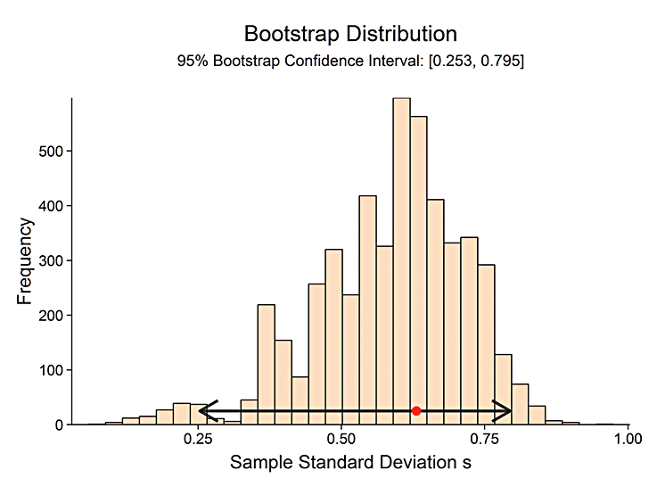
Example: How Variable Are Your Weight Readings on a Scale?
Re-sample with replacement from this sample of size 10 and compute the standard deviation of the new sample.
Figure 8.11 A Bootstrap Frequency Distribution of Standard Deviation Values. These were obtained by taking 100,000 samples of size 10 each from the sample data distribution. Question What is the practical reason for using the bootstrap method?

Slide 60
Example: How Variable Are Your Weight Readings on a Scale?
You now have 100,000 values of the sample standard deviation.
Now, identify the middle 95% of these 100,000 sample standard deviations (take the 2.5th and 97.5th percentiles).
For this example, these percentiles are 0.26 and 0.80.
This is our 95% bootstrap confidence interval for the population standard deviation.
In Summary: A typical deviation of a weight reading from the mean might be rather large, nearly a pound.

